Slide 1
Data Foundations - Udacity
Project 2
Analyze Survey Data
Presentation by:
Spandan Banerjee

Slide 2
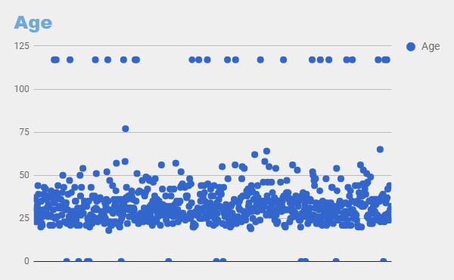
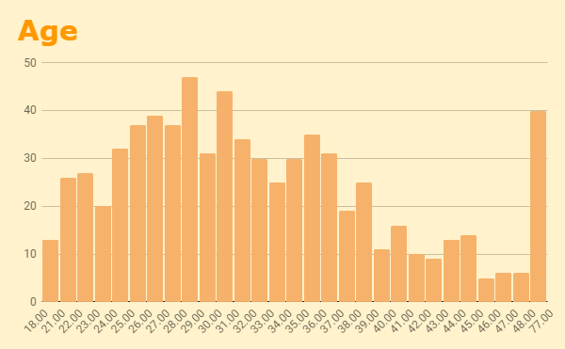
What are the trends in the ages of the participants?
The maximum number of participants are aged 28-29. Outliers in the data have been considered as people whose dates of birth are 2017, people who are aged 117 and people who are not yet born. The second chart has been modified to leave these data out.
Knowledge used: Scattered graph, Histogram, Outliers

Slide 3
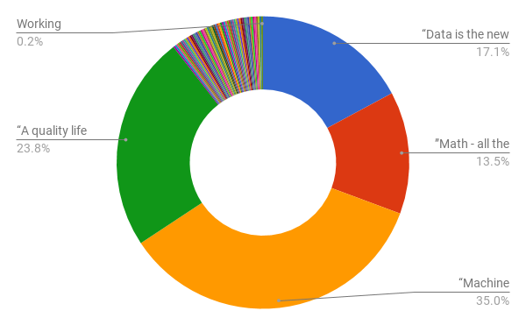
Which is the most common slogan/tagline chosen?
“Machine learning for life” is the most common choice for favorite slogans. It is also observed that most of the participants choosing this slogan are not Machine Learning Engineers. Hence, a general interest in machine learning can be considered a trend within the participants, whether actively involved in the field or not.
Knowledge used: Pie chart (Doughnut)

Slide 4
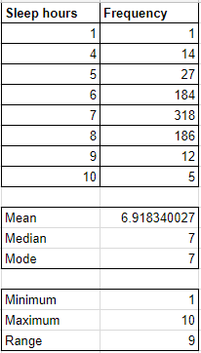
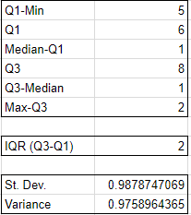
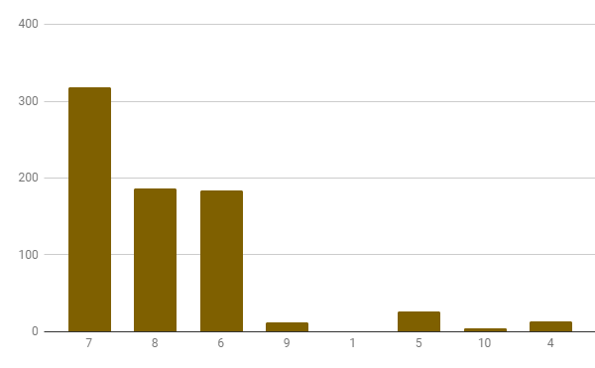
What are the sleep statistics?
Rest is very important for any individual and the trends show a healthy result.
The mode and median of the sleep statistics (excluding the outliers, i.e. erratic values) are both 7 hours, while the calculated mean is approximately 6.92 hours.
The Standard Deviation is approx. 0.988 hours and Variance is approx. 0.976 hour squared.
The calculations have been made in the second sheet of the spreadsheet (shown aside)

Slide 5
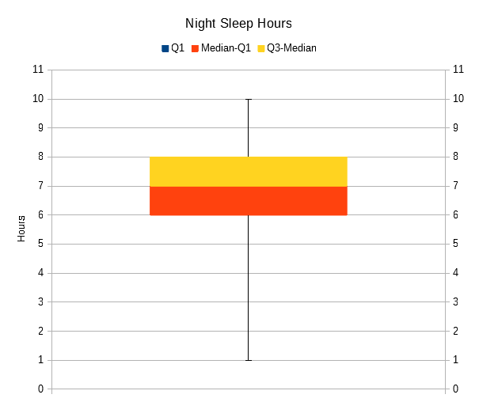
What are the sleep statistics?
The sleep hours during night have been plotted as box plots.
From the plot, we can conclude all that we have concluded in the previous slide.
Knowledge used: Box Plots, Mean, Median, Mode, 5-Number Summary, Standard Deviation, Variance

Slide 6
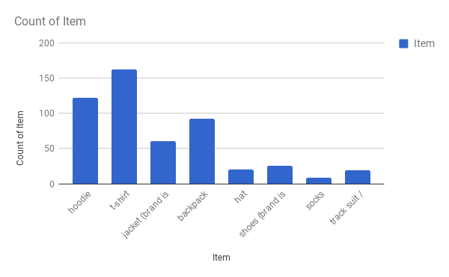
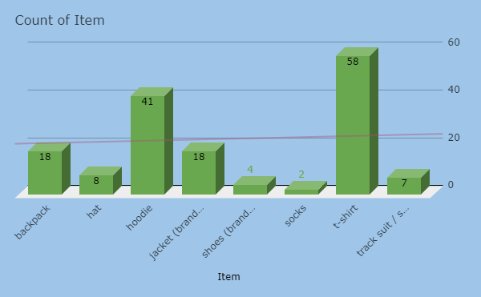
What is the average Udacity Swag choice of employed participants?
While 620 participants reported employment, 133 have reported unemployed (whole population taken into consideration)
Errors lie in the column of employment- answers are not in the desired form in few cases. Also, there are blank answers in the choice of merchandise.
After cleaning the data (sheet 3), we find the most common choice is the t-shirt and the least common choice are the socks.
Knowledge used: Bar graph, COUNT function, Trend lines in graphs

Slide 7


Applications Used

Slide 8
Bibliography
Websites:
https://blogs.office.com
https://support.google.com
https://superuser.com
Books:
Excel 2016 Bible
by Microsoft
Microsoft Excel 2010 Plain and Simple
by Curtis D. Frye

